Slide 1


FAIRWAY DRIVE TRAFFIC CALMING
Meeting with Affected Property Owners
January 15 2:30PM-3:30PM
Fairway Drive RTAP Task Force
FairwayDriveSafety@gmail.com
Notes:
Post in the chat:
The slides are available at: http://...
If you have any questions, please email us at FairwayDriveSafety@gmail.com
Thank you all for coming. Let’s get started, since we have a lot to cover.
I’m ?????
I’m the point of contact for the Fairway Drive RTAP Task Force.
I’ve posted the slides and the task force email address in the chat. So if you have any questions after the meeting, feel free to email us.
You can post questions in the chat and we’ll try to answer all of them when we get to that part of the meeting.

Slide 2
AGENDA
Introduction
Background
RTAP Eligibility
Results of the FCDOT 24-Hour Traffic Study
Why speed on Fairway Drive?
Voting
Traffic Calming Measures
Discussion/Questions
Notes:
This is our agenda for this meeting.
I’m going to go through some of the slides kind of quickly so
we can get to primary objective
which is presenting the Traffic Calming options that FCDOT gave us
and getting to the discussion so we can hear your opinions and preferences.

Slide 3
INTRODUCTION
This is a community-driven effort.
All of the task force members are your neighbors.
No one is here to, or has the power to impose anything on you.
No traffic calming devices will be installed without community buy in.
  We will talk about the voting process later on.
You are key to making our community safer.
Notes:
I just want to make a few key points up front, to hopefully make everyone feel more comfortable with this process:
This is a community-driven effort.
All of the task force members are your neighbors.
No one is here to, or has the power to impose anything on you.
No traffic calming devices will be installed without community buy in.
We will talk about the voting process later on.
You, as the affected property owners, are key to making our community safer.
We are talking to you first because we need your sign-off before any of these devices can be installed.

Slide 4
BACKGROUND
Initiated by residents concerned about pedestrian safety and increasing speeding on Fairway Drive
In 2019, a formal request was made by residents to the Hunter Mill District Supervisor
  Residential Traffic Administration Program (RTAP)
Fairfax County Department of Transportation (FCDOT) conducted an eligibility review
RTAP task force was formed
  Comprised of residents along and surrounding Fairway Drive
  Working with the Supervisor’s office and FCDOT to develop a traffic calming plan
FCDOT provided several traffic calming options to present to the community
Notes:
This RTAP process was started in 2019 with a formal request to Supervisor Alcorn’s office
Repeatedly seeing people running back to the side of the road because of a speeding car, or…
Personally having near misses when crossing Fairway, or
In some cases having multiple family pets killed
Eventually FCDOT conducted an eligibility review to determine if Fairway Drive qualified for the program.
I’ll give more detail about the results of that review in the next few slides.
The bottom line is that we qualified for the program
Once we qualified, the RTAP task force was formed
All of the members are your neighbors that live on, or right off of Fairway Drive
The task force has been working with the Supervisor Alcorn’s office and FCDOT to develop a traffic calming plan for Fairway Drive
With that plan, FCDOT has provided us several traffic calming device options to present to the community

Slide 5
RTAP ELIGIBILITY
The following are the basic criteria that the road must meet in order to qualify for FCDOT RTAP.
March 2020, FCDOT conducted an eligibility review, determining that Fairway Drive met the RTAP criteria. The eligibility review included:
  A traffic count
  A speed survey
  An engineering review
To qualify the road must:
  Be a VDOT maintained road.
  Be classified as a local, residential collector or residential arterial road.
  Have a speed limit of 25 miles per hour (MPH).
  Have a high enough traffic volume (between 500-6,000 vehicles in a 24-hour period).
  Have a speeding problem (85th percentile speed of at least 35 MPH in at least one direction).
  Have a geometry that will allow traffic calming measures to be installed.
Notes:
As far as what was required for us to qualify for the RTAP program
In March of 2020 (right at the start of the COVID shutdowns), FCDOT conducted an eligibility review, which included:
A traffic count
A speed survey
And an engineering review
Which is mostly looking for anything that would cause a problem placing a traffic calming device
To qualify we had to meet all of these criteria, which we did.
The key take away is that we have confirmed and measurable speeding problem on Fairway Drive
“85th percentile speed” is a term used in the traffic study. I’ll explain what that means shortly.

Slide 6
24-HOUR TRAFFIC STUDY
FCDOT conducted a 24-hour traffic study on 3/11/2020
91% of eastbound (North Shore > Wiehle) vehicles, and 84% of westbound (Wiehle > North Shore) vehicles exceeded the posted speed of 25 MPH
27% of eastbound vehicles, and 19% of westbound vehicles were traveling between 35 and 54 MPH
24-Hour Traffic Study Results – Risk of Pedestrian Death or Severe Injury
Speed | 25-29 MPH | 30-34 MPH | 35-39 MPH | 40-44 MPH | 45-49 MPH | 50-54 MPH
Westbound Vehicles | 168 | 156 | 52 | 35 | 15 | 16
Eastbound Vehicles | 144 | 182 | 101 | 41 | 23 | 11
Avg. Risk of Death or Severe Injury* | 32% to 45% | 48% to 62% | 65% to 78% | 81% to 91% | 93% to 99% | 99.8%+
* https://safetyconsult.tech/2019/03/31/impact-speed-and-a-pedestrians-risk-of-severe-injury-or-death/515/
Notes:
As part of the eligibility review, FCDOT conducted a 24-hour traffic study, and this is a summary of the results.
They found that 91% of eastbound vehicles, and 84% of westbound vehicles exceeded the 25 MPH speed limit
27% of eastbound vehicles, and 19% of westbound vehicles were traveling between 35 and 54 MPH
Just to show how dangerous those speeds are, I added the bottom row to this table which comes from a AAA study about the risk of pedestrian severe injury or death when they get hit by a car or light truck going these speeds.

Slide 7
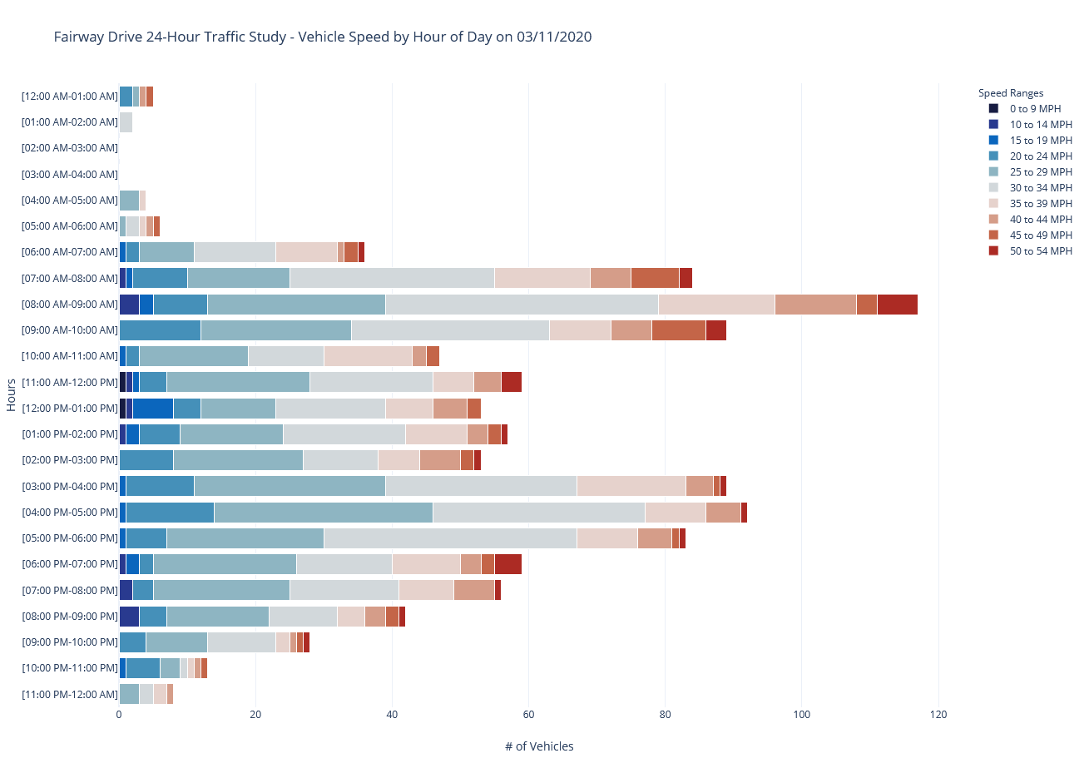
Speed | 25-29 MPH | 30-34 MPH | 35-39 MPH | 40-44 MPH | 45-49 MPH | 50-54 MPH
Avg. Risk of Death or Severe Injury* | 32% to 45% | 48% to 62% | 65% to 78% | 81% to 91% | 93% to 99% | 99.8%+

Slide 8
SPEED KILLS
SUVs and other large vehicles
  Higher front-end profile and weight
  At least twice as likely as cars to kill pedestrians (Eric D. Lawrence, 2018)
Age makes a huge difference (both children and seniors)
Speeders are far more deadly for older pedestrians and children
Notes:
The AAA study only looked at the risk to pedestrians by cars and light trucks.
The prognosis is even worse when you factor in SUVs.
According to another study, pedestrians are at least twice as likely to be killed by an SUV or other large vehicle
Age also makes a huge difference, since being hit is far more deadly for older pedestrians and children.

Slide 9
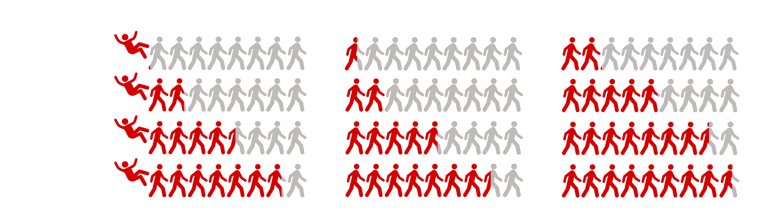
SPEED KILLS
A 70-year-old pedestrian hit by a car going 35 MPH is about as likely to be killed as a 30-year-old hit by a car going 45 MPH (in both cases it’s about a 50/50 chance).
Look at 35 MPH in the chart below. A 30-year-old pedestrian has a 22% chance of dying. A 70-year-old’s chance is over double that, at 54%.
Notes:
As an example of how it is more deadly for older pedestrians…
This graphic shows some of the data from the triple-A study
READ THE BULLETS

Slide 10
85TH PERCENTILE SPEED
Traffic Volume (vehicles in 24-hour period) | 1265 Vehicles
Eastbound 85th Percentile Speed | 40 MPH
Westbound 85th Percentile Speed | 39 MPH
What does that mean?
Defined as the speed at or below which 85 percent of all vehicles observed were traveling
Used as an indication of the speed that drivers perceive to be safe
Assumes most drivers will operate their vehicle at speeds they think are safe
Often used to set speed limits for roads
Notes:
The term “85th percentile speed” is used in the traffic study. So what does that mean?
It’s defined as the speed at or below which 85 percent of all vehicles observed were traveling during the 24-hour period.
It is thought to indicate the speed that drivers perceive to be safe.
Assuming that most drivers will operate their vehicle at speeds they think are safe.
It is commonly used to set speed limits for roads

Slide 11
85TH PERCENTILE SPEED
Can also indicate the design of a road is giving drivers a false sense of security (Marohn, 2020)
“If we want drivers to slow down, we don’t ignore human behavior. We change the road design to make it feel less safe for drivers to speed.” (emphasis added)
“In other words: we change the street design to reflect reality.” (Marohn, 2020)
This is where many of the traffic calming measures come into play
Marohn, C. (2020, July 27). Understanding the 85th Percentile Speed. Retrieved from Strong Towns: https://www.strongtowns.org/journal/2020/7/24/understanding-the-85th-percentile-speed
Notes:
Another view on the 85th percentile speed is that it also indicates the design of a road is giving drivers a false sense of security.
From the study I’m quoting here “If we want drivers to slow down, we don’t ignore human behavior. We change the road design to make it feel less safe for drivers to speed.”
Another way of saying that is that we need to change the street design to reflect reality.
This is where many of the traffic calming measures come into play, because they are intended to narrow the road and make it less comfortable for people to speed.

Slide 12
WHY SPEED ON FAIRWAY DRIVE?
…or, what is giving speeders a false sense of security on Fairway Drive?
No centerlines
Few parked cars
No crosswalks, so pedestrians aren’t expected
No stop signs to hinder progress
We also have the scary left turn from Wiehle with the blind hill (blind summit)
  People gun it to make the turn and enter Fairway already speeding
Which adds up to a nice wide road to speed down, with very little to slow you down.
Notes:
Why do people speed on Fairway, or what is giving them a false sense of security?
Well Fairway Drive has…
No centerlines
Few parked cars on most of the road
No crosswalks, so pedestrians aren’t expected to be in the roadway
No stop signs to hinder progress
We also have that scary left turn from Wiehle with the blind hill (blind summit)
People gun it to make that turn and enter Fairway already speeding
All of this adds up to a nice wide road to speed down, with very little to slow you down.

Slide 13
EARLY EFFORTS - VDOT
There were efforts to address the problems before RTAP
There was a meeting with VDOT engineers on Fairway Drive to talk about options
…and guess what VDOT said NO to…
  Centerlines
  Crosswalks
  Stop signs
Notes:
There were some earlier efforts to address the problems before we applied for RTAP
There was a meeting with VDOT engineers on Fairway Drive to talk about some options
…and unfortunately they said NO to all of the stuff we just listed as possible causes of speeding

Slide 14
VOTING
We are currently at step three of the RTAP process, which is "Plan Development".
We are still working with FCDOT to develop the plan and negotiate the options with “affected property owners”
  Affected Property Owners - the properties closest to the spots where any possible traffic calming devices might be installed.
Once we have a plan, we need to get sign off from the affected property owners (the first "vote“).
Step four of the process is "Community Engagement".
  Neighborhood outreach
  Community information meeting will be held for the households in the voting ballot area.
Step five is "Community Vote".
Notes:
I’m going to give a quick overview of how the traffic calming measures will be voted on.
We are currently at step three of the RTAP process, which is "Plan Development".
And we are still working with FCDOT to develop the plan
and we still need to get your buy in
Once we have a plan, and we get your sign-off, we will hold a Community Meeting and invite everyone in the voting area
After the meeting, the task force will work with FCDOT on any changes needed to the plan, based on feedback from the meeting
Then we advertise the updated plan and it gets voted on by the community

Slide 15
VOTING
FCDOT decides what the “voting ballot area” is. It’s comprised of…
109 residences
  Residences on Fairway Drive, up to Hook Road, and
  Residences "on other streets whose sole or primary access is" Fairway Drive, "and who would be considerably inconvenienced if they chose an alternate route.“¹
55 “YES” votes (over 50%) are required for the plan to pass.
Note that if a residence does not vote it counts as a “NO”
It will be important for everyone that wants the plan to succeed to actually send in a ballot.
1. FCDOT RTAP General Operating Procedures: https://www.fairfaxcounty.gov/transportation/sites/transportation/files/assets/documents/pdf/parking/rtap-general-operating-procedures.pdf
Notes:
FCDOT decided what the “voting ballot area” is.
It’s comprised of 109 residences
Residences on Fairway Drive, up to Hook Road and, to quote from the RTAP rules…
those "on other streets whose sole or primary access is" Fairway Drive, "and who would be considerably inconvenienced if they chose an alternate route.“
We will need 55 “YES” votes (which is over 50%) to pass the plan.
If a residence does not vote it counts as a “NO”
So it will be really important for everyone that wants the plan to succeed to actually send in their ballot.

Slide 16
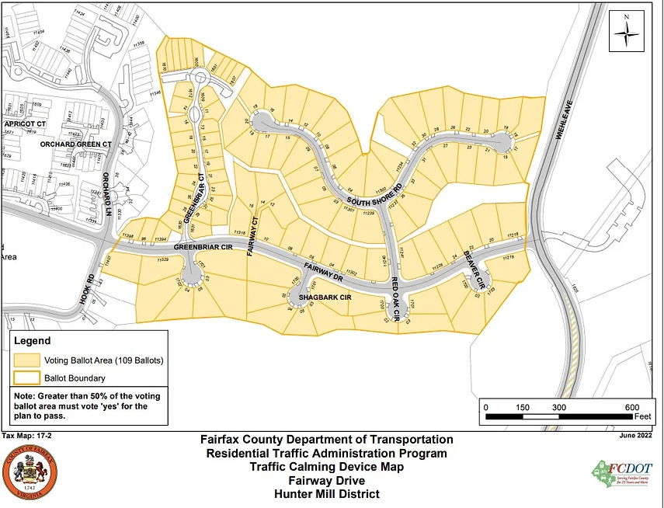
VOTING BALLOT AREA

Slide 17
TRAFFIC CALMING MEASURES
We need each affected property to decide which device option they will support
  We need your choice by January 31
It is important to remember…
  Traffic calming measures work best when repeated within certain intervals
  Large gaps can make speeding worse between devices
Notes:
We will need each affected property give us their choice of which device option they will support
We need your choice by January 31
As we are discussing the different devices and you are deciding, I need you all to keep in mind that…
Traffic calming measures work best when repeated within certain intervals
Large gaps can make speeding worse between devices

Slide 18
TRAFFIC CALMING MEASURES
Measures proposed by FCDOT:
  Speed Hump
  Speed Lumps
  Speed Table
  Raised Median Island
  Choker

Slide 19
BACKUP SLIDES

Slide 20
SPEED HUMP
ADVANTAGES
  They are very common, so I’m sure everyone is familiar with them
  Because of this, they may promote a quicker response by drivers to slow down.
  Average speeds between humps reduced between 20 and 25 percent.
  Average 85th percentile speed reduction is 5-8 mph.
  No parking impact, given that vehicles are allowed to park on speed humps.
DISADVANTAGES
  Can increase noise to nearby residents as larger vehicles pass over the device.
  Impedes bicyclists.
  Speeds typically increase approximately 0.5 to 1 mph midway between humps for each 100 feet.
  Impacts travel times of emergency vehicles:
  The delay is approximately…
    Between 3 and 5 seconds per hump for fire trucks
    and up to 10 seconds for ambulances with patients.
  This delays can be addressed by using Speed Lumps (see below).

Slide 21
SPEED LUMP
DESCRIPTION
  A Speed Lump is a modified Speed Hump where openings are added to accommodate emergency vehicles or other large vehicles.
  The emergency vehicles uses the openings so it doesn’t slow them down.
  However, the lumps are spaced to ensures that regular vehicles have to go over at least one set of lumps.
ADVANTAGES
  Average 85th percentile speed reduction is 5-7 mph. About the same as speed humps.
  Has almost all of the advantages of Speed Humps, plus..
  They produce less noise than speed humps for large vehicles.
  They are also better for bicycles than speed humps, because they can just go through the openings.
DISADVANTAGES
  They address a number of the disadvantages of speed humps, but…
  You still have the 0.5 to 1 mph speed increase between devices for each 100 feet.
  And you can still increase noise to nearby residents as larger vehicles pass over the device.
  In addition, they may encourage passenger vehicles to cross into the opposite lane to try and straddle the gaps used by emergency vehicles.
    It won’t work, but that won’t stop someone from trying it.
    One way to discourage this is to put a centerline stripe approaching the speed lump in each direction.
    We already have people riding down the middle of the road because we don’t have a centerline. This will likely not make much of a difference.

Slide 22
SPEED TABLE
DESCRIPTION
  Another variation on a Speed Hump.
  They have a flat top or “table”, so they provide a gentler transition than speed humps or lumps, so less driver discomfort.
ADVANTAGES
  Less impact on emergency vehicles than speed humps. Average of 3 seconds for fire trucks.
  Be reduction in the average 85th percentile speed than speed humps and lumps, 6-9 mph.
  They produce less noise than both speed humps and speed lumps. Speed lumps are still better for large vehicles that can use the gaps.
DISADVANTAGES
  They addresses some of the disadvantages of speed humps, but…
  You still have the 0.5 to 1 mph speed increase between devices for each 100 feet.
  They still impede bicycles.
  And you can still increase noise with larger vehicles, but less than speed humps.
  In addition, they may encourage passenger vehicles to cross into the opposite lane to try and straddle the gaps used by emergency vehicles.
    It won’t work, but that won’t stop someone from trying it.
    One way to discourage this is to put a centerline stripe approaching the speed lump in each direction.
    We already have people riding down the middle of the road because we don’t have a centerline. This will likely not make much of a difference.

Slide 23
RTAP ELIGIBILITY – FCDOT ENGINEERING REVIEW
The road has to have “a geometry” that will allow traffic calming measures to be installed.
Which basically means they look at things like:
  Road width
  Curves and sight distances
  Elevation or hills
  Locations of intersections, sidewalks, curbs, and driveways
  Also locations of
    Water and sewer
    Utilities like gas, electric, and telephone
    Storm drainage
Essentially anything that would cause a problem placing a device

Slide 24
FCDOT RULES/LIMITS
Vertical Devices (Speed Humps, Lumps, Table):
  Minimum of 300 feet between measures and from existing stop conditions.
  Minimum of 150 feet from an intersection.
  Minimum of 150 feet of sight distance to a device.
Horizontal Device (Chokers or Medians):
  Minimum of 200 feet from the nearest traffic calming measure.
  Minimum of 150 feet from an intersection.
FCDOT requires a minimum of 150 feet of sight distance to a device to ensure that drivers will have adequate time to take precautionary measures.

Slide 25
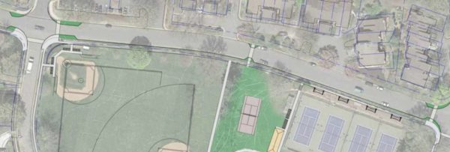
HOOK ROAD WORKING GROUP PLAN
Why does the RTAP plan stop at Hook Road?
In 2017, Reston Association kicked off a revitalization project for the Hook Road Recreation Area
The working group selected a final plan, which prioritizes traffic calming
  Roadway bump-outs and a crosswalk on Fairway Drive
  Still subject to VDOT approval
Larry Butler, RA COO, has been working with the us to coordinate efforts

Slide 26
SEVERE INJURY
The U.S. Department of Transportation (DOT) defines a severe injury as any harm that is not fatal and results in one or more of the following:
  Severe laceration with exposure of underlying tissue, muscle or organs, or causing significant blood loss
  Broken or distorted arms or legs
  Compression of body parts
  Possible skull, chest or abdominal injury
  Second- or third-degree burns that cover 10% or more of the body
  Leaving the accident scene in a state of unconsciousness
  Paralysis

Slide 27
TEN GOOD REASONS FOR TRAFFIC CALMING
Just for fun, I asked OpenAI’s ChatGPT artificial intelligence chatbot for ten good reasons for traffic calming. Here is what it said.
Reduced speeds: Traffic calming measures can effectively reduce vehicle speeds, improving safety for pedestrians and bicyclists.
Enhanced pedestrian safety: By reducing vehicle speeds, traffic calming measures can help to prevent pedestrian accidents and injuries.
Improved quality of life: Traffic calming measures can help to reduce noise and air pollution, improving the overall quality of life in a community.
Encouragement of walking and biking: Traffic calming measures can make it safer and more appealing for people to walk and bike, promoting active transportation and improving public health.
Increased property values: Traffic calming measures can improve the aesthetic appeal of a community, which can lead to increased property values.
Enhanced community livability: Traffic calming measures can help to create a more livable and pleasant environment for residents.
Increased driver awareness: Traffic calming measures can help to increase driver awareness and encourage more cautious driving.
Enhanced emergency vehicle response times: By reducing vehicle speeds, traffic calming measures can help to improve emergency vehicle response times.
Improved traffic flow: Traffic calming measures can help to reduce congestion and improve traffic flow, making it easier for drivers to navigate through a community.
Reduced accidents: Traffic calming measures can help to reduce the number of accidents and injuries on the road.

